Slide 1

Methods for Comparative Effectiveness and Patient-Centered Outcomes Research
Maria E. Suarez-Almazor, MD, PhD
Barnts Family Distinguished Professor
Department of Health Services Research
University of Texas MD Anderson Cancer Center
msalmazor@mdanderson.org

Slide 2
Overview
Basic methods of Comparative Effectiveness Research
Evidence synthesis
Observational studies
Pragmatic clinical trials

Slide 3
CER: Comparative Effectiveness Research
PCOR: Patient-Centered Outcomes Research
RWE: Real-World Evidence

Slide 4
Key Elements of Comparative Effectiveness Research
Goal: to inform health care decisions for selected populations
Effectiveness (real-world) vs. efficacy (selected populations and controlled environment)
Comparisons of different alternatives

Slide 5
Major Methodologies in CER
Evidence synthesis
  Research on existing data
Generation of new data (real-world studies)
  Observational research (cohort and registry studies)
  Effectiveness/pragmatic clinical trials

Slide 6
Evidence Synthesis

Slide 7
Evidence synthesis
Research methodology that identifies, selects, appraises, combines and analyzes data from multiple sources of information
The goal is to identify and synthesize all the available information on a topic of interest
Systematic reviews
Meta-analysis
Decision analysis

Slide 8
Systematic Review
A summary of research results (evidence) that uses explicit and reproducible methods to systematically search, critically appraise, and synthesize on a specific issue
It synthesizes the results of multiple primary studies related to each other by using strategies that reduce biases and errors
https://guides.temple.edu/c.php?g=78618&p=9548660

Slide 9
A Systematic Review is Different from a Traditional Narrative Review
Clearly stated objectives with well-defined question (PICOTS)
A priori protocol (needs to be registered – PROSPERO, etc)
Pre-defined eligibility criteria for studies
Explicit, reproducible methodology
Systematic search that attempts to identify all studies that would meet the eligibility criteria
Assessment of the validity of the findings of the included studies (assessment of risk of bias)
Systematic synthesis and reporting of the characteristics and findings of the included studies

Slide 10
Meta-analysis
Meta-analysis is the use of statistical methods to summarize the results of independent studies - quantitative
Many but not all systematic reviews contain meta-analyses
By combining information from all relevant studies, meta-analyses can provide more precise estimates than those derived from individual studies
Evaluate consistency of evidence vs. differences across studies

Slide 11
Steps in Systematic Reviews
Formulate question
Develop protocol( e.g. PROSPERO)
Search strategy
  Librarian
  Can use more than one database: Medline, EMBASE
  Needs to be broad to increase sensitivity
Study selection
  Explicit criteria (inclusion and exclusion)
  Type of study, interventions, participants, outcomes, length of follow-up
  2 independent reviewers select studies. Disagreement resolved by consensus or by arbitrator
Data extraction
  2 reviewers or 1 reviewer cross-checked by second

Slide 12
Steps
Evaluate risk of bias of studies
  Different tools according to type of study: clinical trial, cohort study, etc
Synthesize results
  Qualitative
  Quantitative: meta-analysis if studies are similar enough
Assess quality of the evidence
  Robustness of findings
Present results
  PRISMA (Preferred Reporting Items for Systematic Reviews and Meta-Analyses)

Slide 13
How to Formulate a Good Research Question
Clear and understandable
Focused
Original and novel (new information)
Relevant
- change current ideas or practice
- lead to new research
Feasible (time and resources)

Slide 14
PICOTS Framework
P Population (who)
I Intervention or issue (what are we examining)
C Comparator (compared to)
O Outcome (what happens)
T Timing (when)
S Setting (where)

Slide 15
PRISMA flowchart
Ruiz JI, Lopez-Olivo MA, Geng Y, Suarez-Almazor ME. COVID-19 Outcomes in Patients with Cancer Receiving Immune Checkpoint Inhibitors: A Systematic Review. J Immunother Precis Oncol. 2023 Feb 22;6(2):103-110. doi: 10.36401/JIPO-22-24. PMID: 37214207; PMCID: PMC10195019.
25 studies
21 cohort studies
1 case series
3 case reports

Slide 17
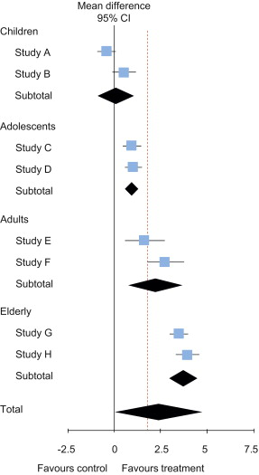
Heterogeneity
Hypothetical meta-analysis of trials, using a random-effects model, with subgrouping by age categories.
Dotted vertical line represents the threshold for clinical relevance.
Test for heterogeneity: I² = 67%, p = 0.04.
Not appropriate
Verhagen AP , Ferreira ML. Forest Plots.
J Physiotherapy. 2016
https://doi.org/10.1016/j.jphys.2014.06.021

Slide 18
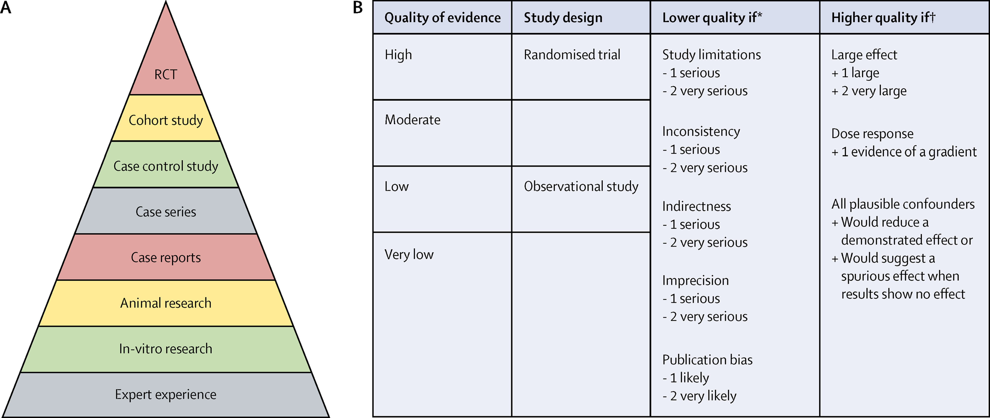
Evidence-Based Medicine (EBM)
Hierarchy of Evidence from Studies
Initial Pyramid
GRADE
Djulbegovic B, Guyatt GH. Progress in evidence-based medicine: a quarter century on. Lancet. 2017 PMID: 28215660.

Slide 19
HOW DO WE EXPRESS HOW CERTAIN WE ARE IN THE RESULTS?
GRADE: Four levels of certainty
Certainty level |  | Grade
High | We are very confident that the true effect lies close to that of the estimate of the effect | ⊕⊕⊕⊕
Moderate | We are moderately confident in the effect estimate: The true effect is likely to be close to the estimate of the effect, but there is a possibility that it is substantially different | ⊕⊕⊕⊝
Low | Our confidence in the effect estimate is limited: The true effect may be substantially different from the estimate of the effect | ⊕⊕⊝⊝
Very low | We have very little confidence in the effect estimate: The true effect is likely to be substantially different from the estimate of effect | ⊕⊝⊝⊝
Notes:
Before we consider individual factors affecting certainty of evidence, it’s useful to get a picture of levels used in the GRADE approach. Certainty of evidence can be high, moderate, low, or very low. Each of these levels are defined in terms of our confidence in the effect estimate and how likely the true effect is close to this estimate. GRADE levels of certainty are visually represented by up to four pluses in small circles.

Slide 20
Summary of Results

Slide 21
Initial rating depends on study design for body of evidence
BODY OF EVIDENCE FROM RCT
4 – high​
​
​
3 – moderate​
​
​
2 – low​
​
​
1 – very low
BODY OF EVIDENCE FROM NON –RANDOMIZED STUDIES

Slide 22
Certainty of evidence: rating down
4 – high (RCT)
3 – moderate
2 – low
1 – very low
  risk of bias
  imprecision
  inconsistency
  indirectness
  publication bias
rating down 1 level for serious concerns​
rating down 2 levels for very serious concerns​
some (minor) concerns on more than one domain can amount to one full level rated down
Notes:
There are five factors that can lead to downgrading the level of evidence provided by randomized trials:
Risk of bias – were the studies valid, and likely to produce an accurate estimate of the ‘true’ effect?
Inconsistency – how consistent were the results across studies?
Imprecision – how wide were the confidence intervals? Can we be confident that the true effect occurs in only one particular direction?
Indirectness – do the characteristics of the included studies directly match our review question, in terms of patients and setting, intervention, or outcomes measured?
Publication bias – do we think we have found all the studies addressing this particular question?
If there are concerns around any of these factors, the level of evidence will go down.

Slide 23
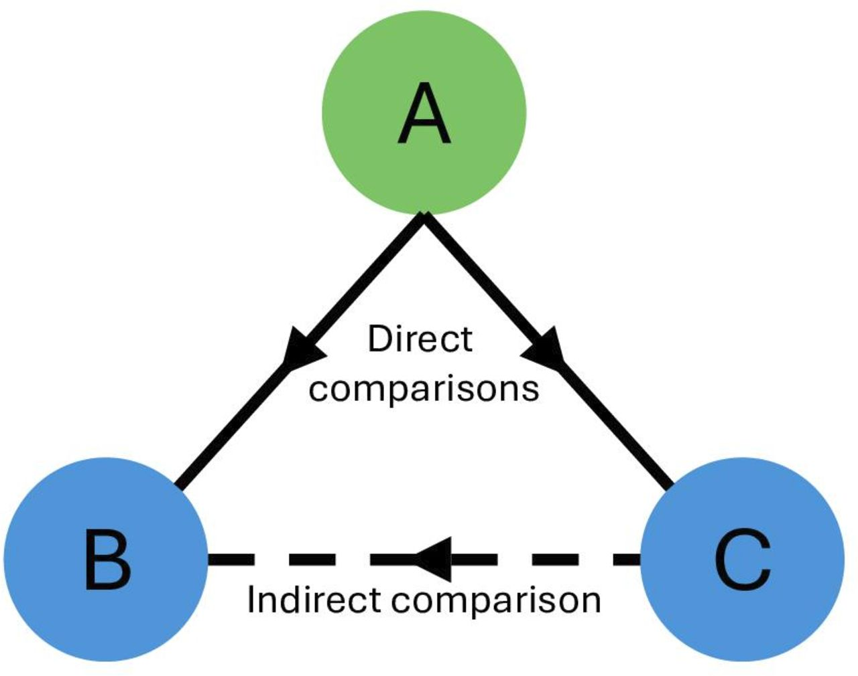
Indirect comparison
Trial 1
Trial 2

Slide 24
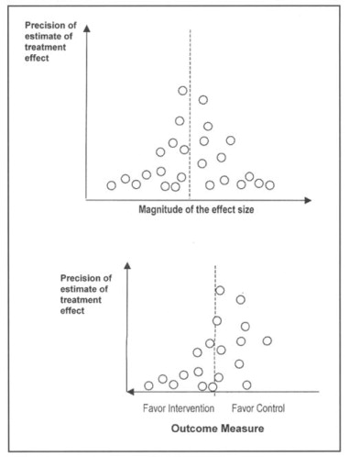
Publication bias: funnel plots
Montori, Victor M. et al. Publication Bias: A Brief Review for Clinicians. Mayo Clinic Proceedings 2000: 75, 1284 - 1288

Slide 25
Decision Analysis Model
Quantitative approach that uses mathematical modeling to aid in decision-making by providing probabilities of events under different scenarios
Often used in cost-effectiveness evaluations to establish value
  How much it costs to attain a certain outcome
Can use data from different sources
Different methodologies
  Simple model is a decision tree

Slide 26
Chance node
Decision node
Te Ao BJ, Brown PM, Feigin VL, Anderson CS. Are stroke units cost effective? Evidence from a New Zealand stroke incidence and population-based study. Int J Stroke. 2012 Dec;7(8):623-30. doi: 10.1111/j.1747-4949.2011.00632.x. Epub 2011 Oct 20. PMID: 22010968.

Slide 27
Observational Studies

Slide 28
Observational Studies vs Clinical Trials
Observational Studies
Research studies in which researchers collect information from participants or look at data that was already collected
Cross-sectional
Case-control (always retrospective)
Cohort studies (prospective or retrospective)
Clinical Trials (always experimental)
Research studies in which researchers test health-related interventions by assigning participants to receive intervention(s)
Explanatory (efficacy) ideal conditions
Pragmatic (effectiveness) real-world

Slide 29
Sources of Data for Observational Studies in CER
Large prospective population-based cohorts
Retrospective
  Existing cohort studies
  Registries (specific populations, health interventions)
  Claims data (Medicare, MarketScan, IQVIA, etc)
  Electronic Health Records (EHR)

Slide 30
RWE: Real-World Evidence
Real-world data (RWD) are data relating to patient health status and/or the delivery of health care routinely collected from a variety of sources.
Examples of RWD include data derived from electronic health records, medical claims data, data from product or disease registries, and data gathered from other sources (such as digital health technologies).
Real-world evidence (RWE) is the clinical derived from analysis of RWD.
https://www.fda.gov/science-research/science-and-research-special-topics/real-world-evidence

Slide 31
Uses and Advantages of Observational Studies
Real-world
Large sample sizes
Multiple interventions can be compared
Longer follow-ups
Often needed for safety studies/rare outcomes (e.g. mortality)
Readily available data to answer research question (retrospective)
Less expensive
Major disadvantage: subject to bias and confounding

Slide 32
Observational Studies in CER
Hypothesis-testing vs. descriptive
Broad population
Explicit protocol
  Easy to go on fishing expedition
Use methodologies that control confounding and bias
  Try to approach what a RCT would be

Slide 34
PCORI Methodology Standards for Use of Registries
Registries must have the following characteristics
Documentation registry purpose and protocol
Data safety and security
Data elements and quality
  Standardized data elements
  Quality assurance plan
Availability of data to control for confounding
Systematic participant enrollment
Explicit participant follow-up
Clear documentation of registry materials and protocols

Slide 36
Pragmatic Clinical Trials

Slide 37
Clinical Trials (always experimental)
Research studies in which researchers test health-related interventions by assigning participants to receive intervention(s)
Explanatory (efficacy) ideal conditions
Pragmatic (effectiveness) real-world

Slide 38
Pragmatic Clinical Trials
Designed to study a health intervention in a real-world setting that is similar or identical to the one in which the intervention will be implemented
In contrast to explanatory or traditional trials, which are designed to demonstrate the safety and efficacy of an intervention
    under highly controlled conditions
    in carefully selected groups of participants
Most clinical trials are situated somewhere along the spectrum between pragmatic and explanatory
https://rethinkingclinicaltrials.org/archived-what-is-a-pragmatic-clinical-trial/pragmatic-elements-an-introduction-to-precis-2/

Slide 39
Explanatory vs Pragmatic Trials
 | Explanatory | Pragmatic
Population | Highly selected | Little selection - Broad
Interventions | Strictly applied | Flexibility in co-interventions, dosage, etc
Comparator | Placebo or another intervention | Usual care
Outcome measures | Sometimes surrogate or clinical only | Patient-centered
Data collection | Additional procedures outside clinical care | In clinical settings

Slide 40
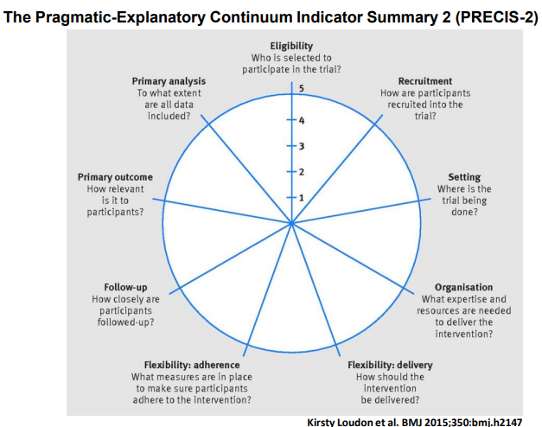
\
Very explanatory
Rather explanatory
Equally pragmatic and explanatory
Rather pragmatic
Very pragmatic

Slide 41
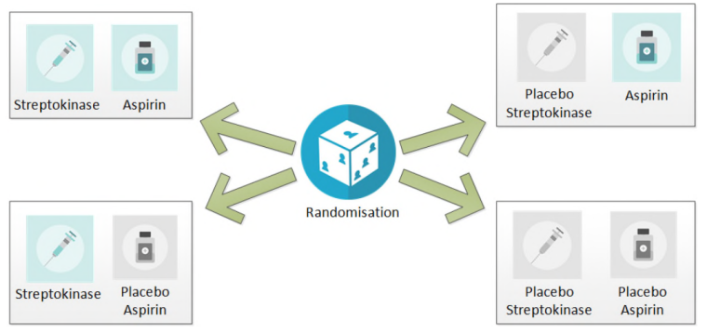
ISIS-2 trial – 17,187 cases of suspected acute myocardial infarction
(Lancet 1988)

Slide 42
ACP- PEACE. Promoting Effective and Aligned Communication in the Elderly

Slide 43
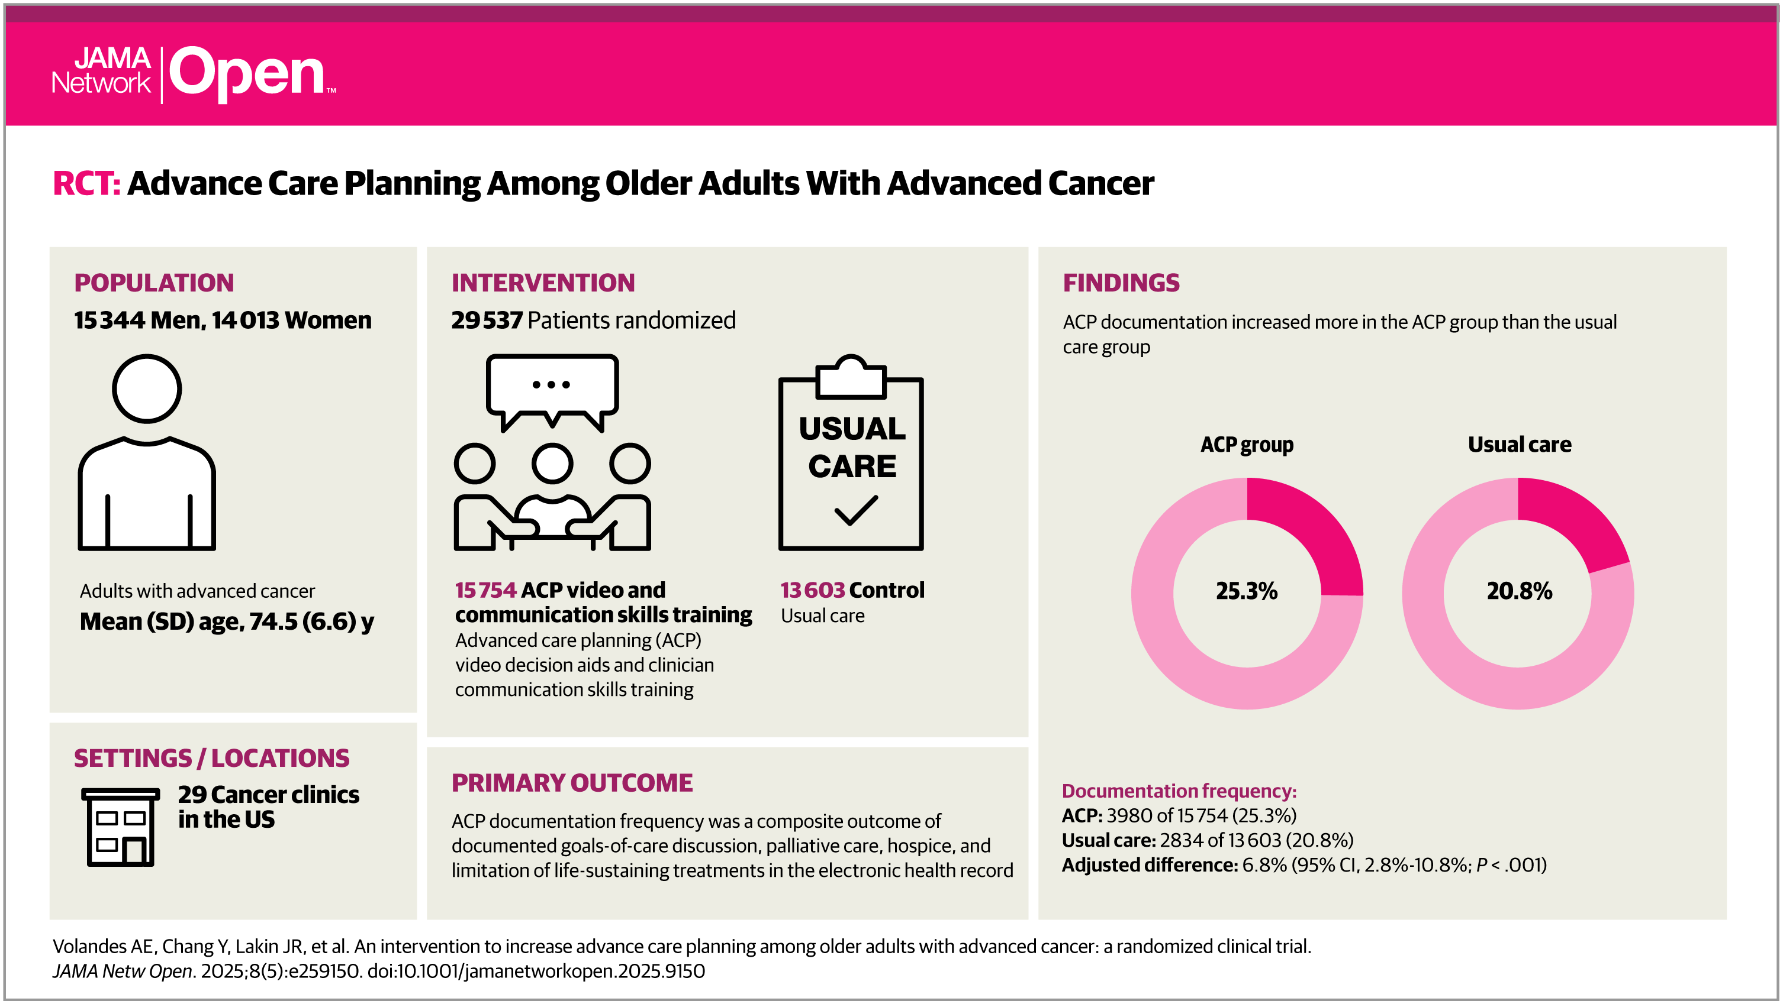

Slide 44
“Far better an approximate answer to the right question, which is often vague, than an exact answer to the wrong question, which can always be made precise.”
John Tukey

